Slide 1
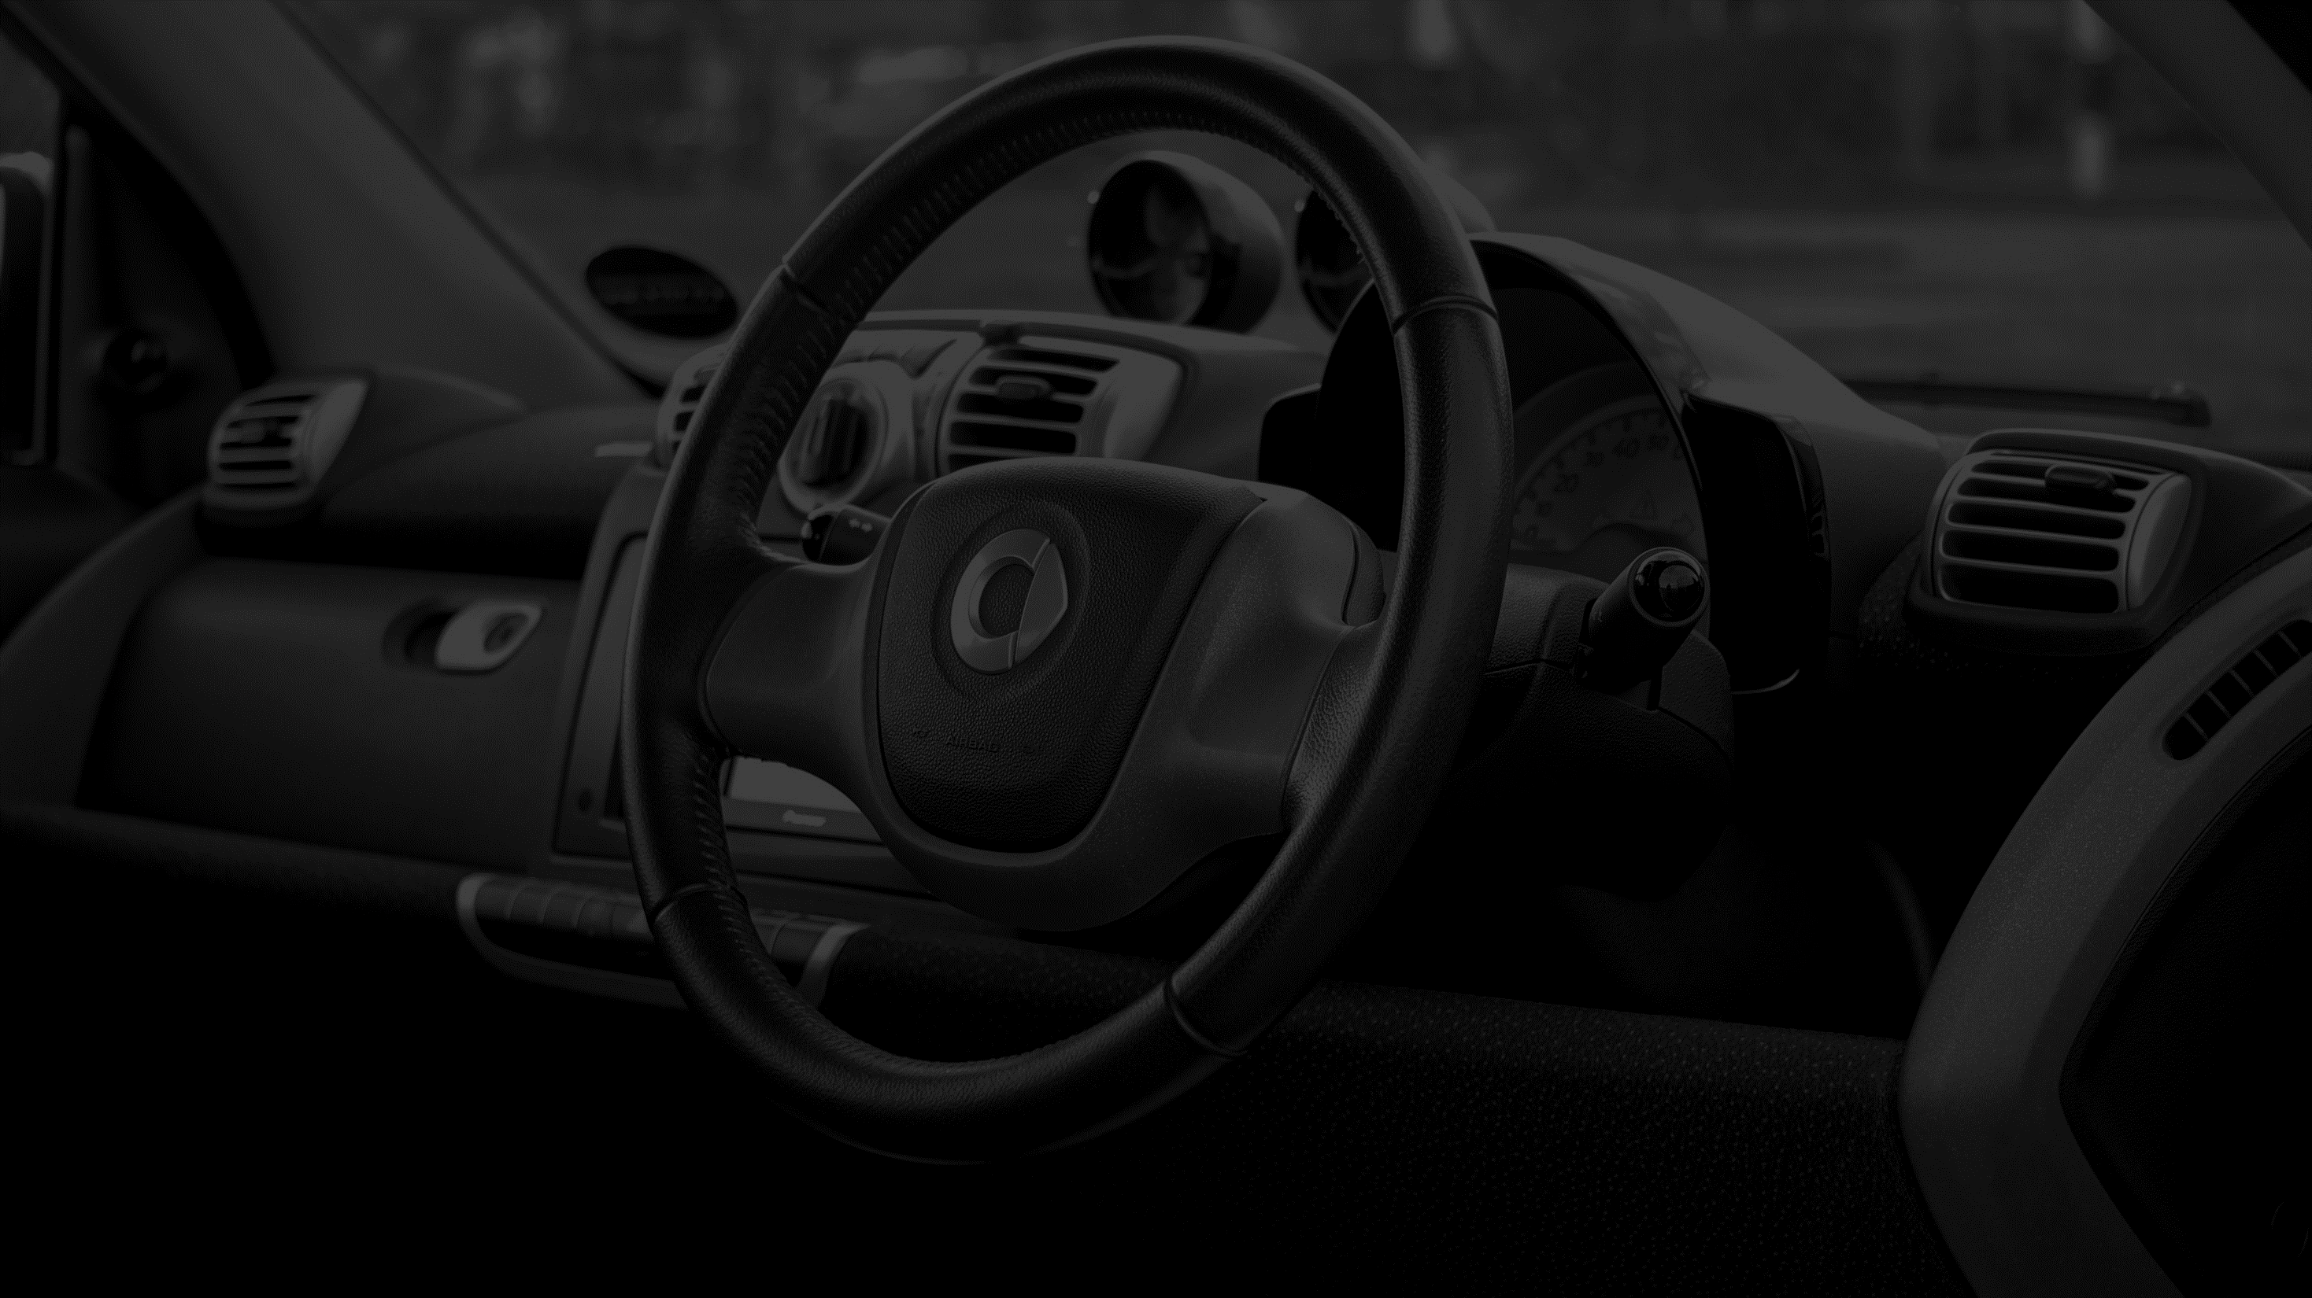
OverSee: an AI based driver state monitoring system
GOLF-A

Slide 2
Team Members
201814030 Tasnia Iqbal
201814054 Tasneem Mubashshira
201814060 Ifath Ara
201814061 Fariha Fardina Amin

Slide 3
Objective of our project
Making a Dedicated device for monitoring the driver while driving
01
Alarming the driver as well as the passenger to avoid accidents
02
Giving automatic suggestion for improving driver’s current state
03

Slide 4

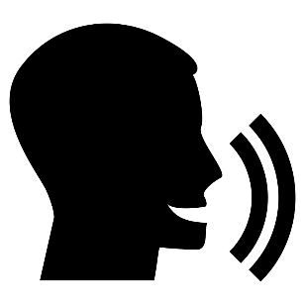


Features
Suggesting nearest parking slot / coffee shop
in Google Map
Drowsiness Detection
Anger/Emotion Detection
Inattention Detection

Slide 5
Hardware Equipment
Microcontroller (Raspberry pi)
Pi Camera
Display
Sound Box
GPS sensor
IMU sensor (accelerometer)

Slide 6
Circuit Diagram

Slide 7
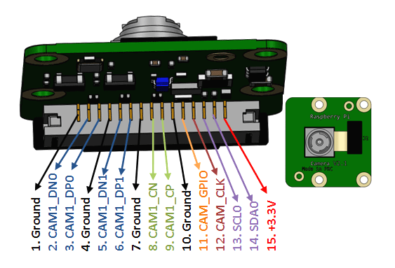
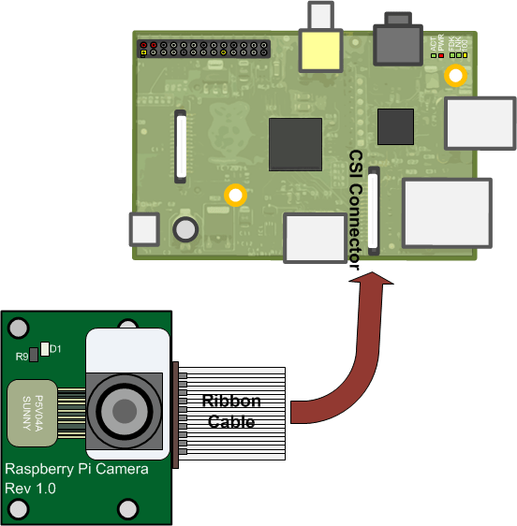
Raspberry Pi Camera Module 5M
This 5mp camera module is capable of 1080p video and still images and connects directly to your Raspberry Pi.

Slide 8
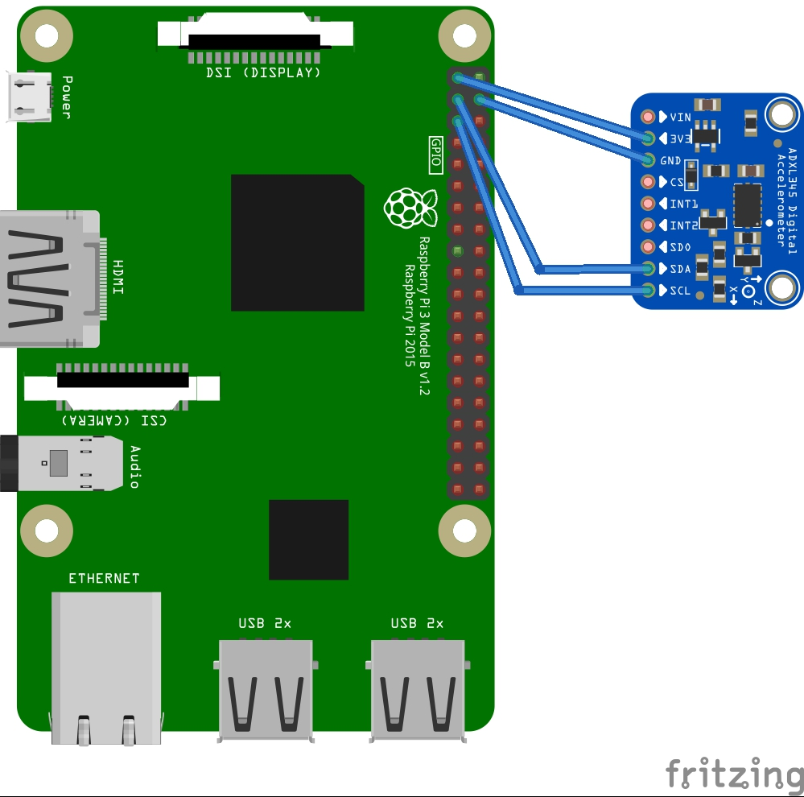
Accelerometer Sensor Module MPU-9250
MPU-9250 IMU Breakout features the latest 9-axis MEMS sensor which contains a 3-axis gyroscope as well as a 3-axis accelerometer, and the AK8963, which features a 3-axis magnetometer.

Slide 9
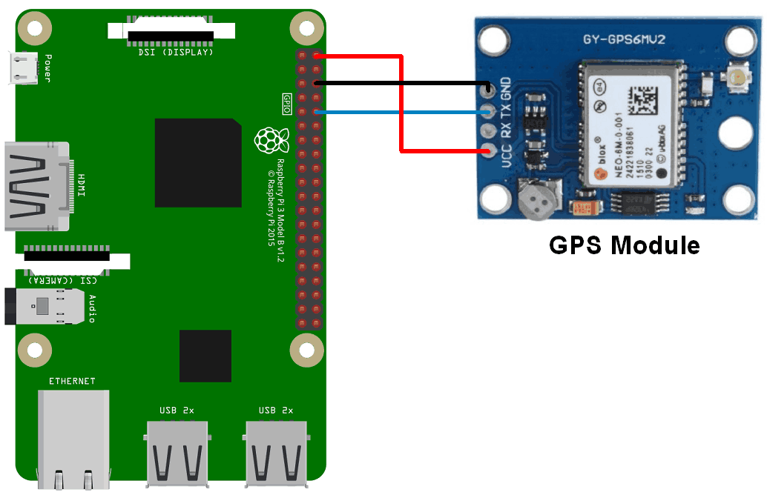
GPS Module NEO-6MGPSModule
The NEO-6M GPS module is a well-performing complete GPS receiver with a built-in 25 x 25 x 4mm ceramic antenna, which provides a strong satellite search capability. With the power and signal indicators, you can monitor the status of the module.

Slide 10
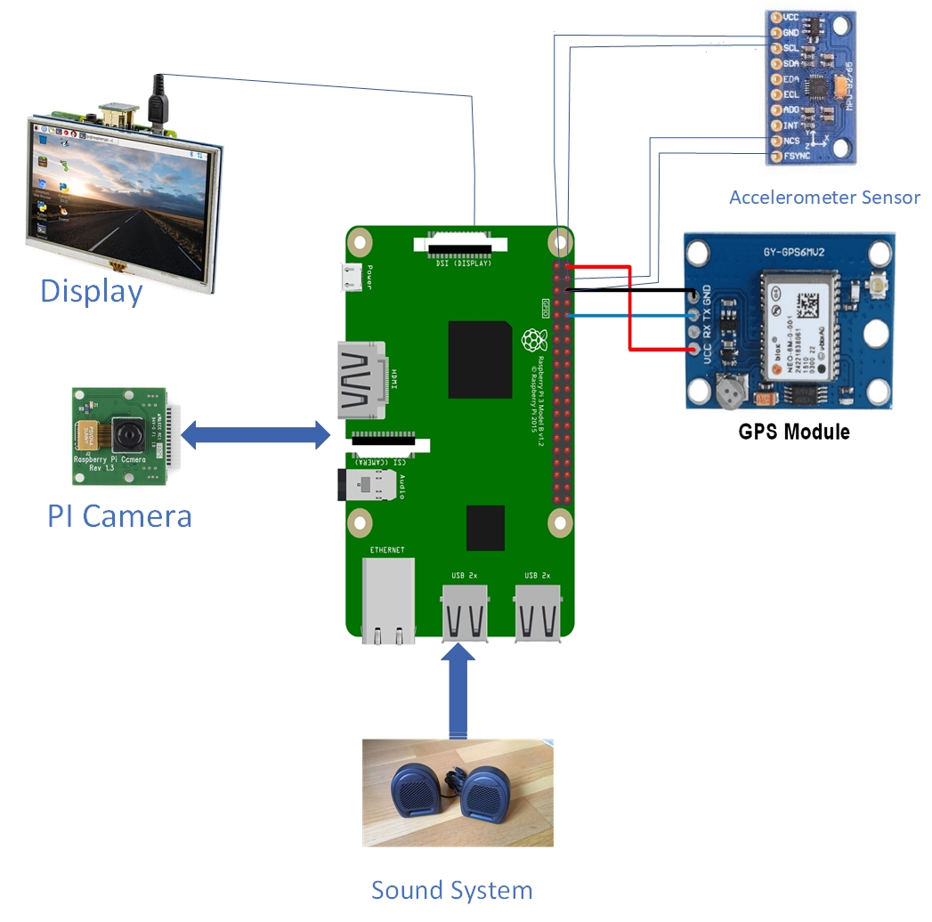
Total circuit Diagram

Slide 11
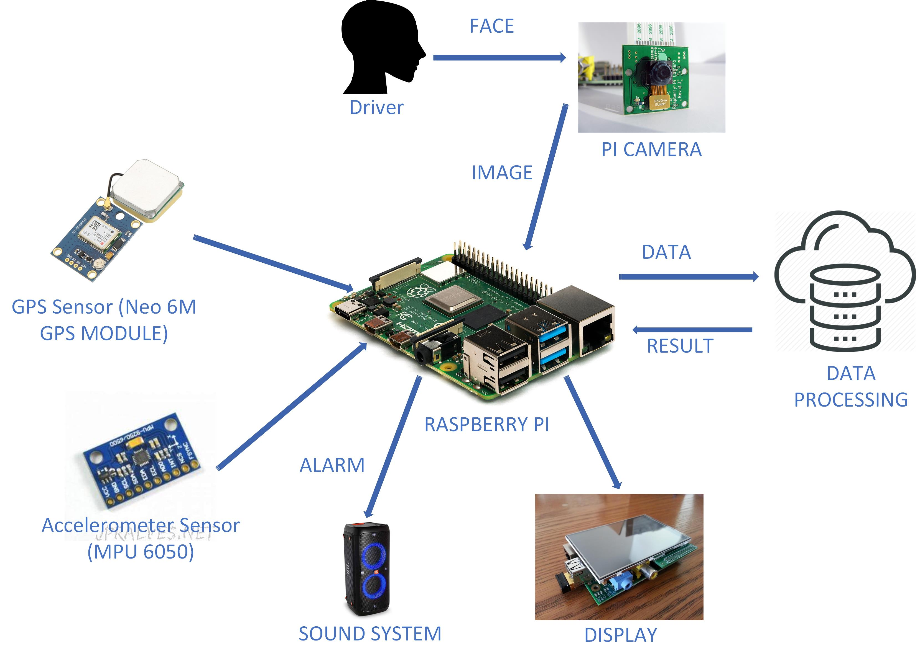
System Architecture

Slide 12
Oversee Hardware Timeline
Week 2
Week 3
Week 4
Week 5
Week 6
Connection Diagram of Raspberry pi and sensors
Components Collection
Raspberry Pi OS installation
+
Display Setup
(Ifath)
Pi Cam Setup
+Testing
(Fariha)
Soundbox setup+Testing
(Tasneem)

Slide 13
Oversee Hardware Timeline
Week 8
Week 10
Week 11
Week 12
Week 13
accelerometer setup
+Testing
(Tasnia)
GPS module setup
+Testing
(Tasnia)
Pi camera
+ Sound box setup together
(Fariha)
GPS module+
Accelerometer setup together
(Tasneem)
Total
Integration
(Ifath)

Slide 14
Thank You

